Slide 1

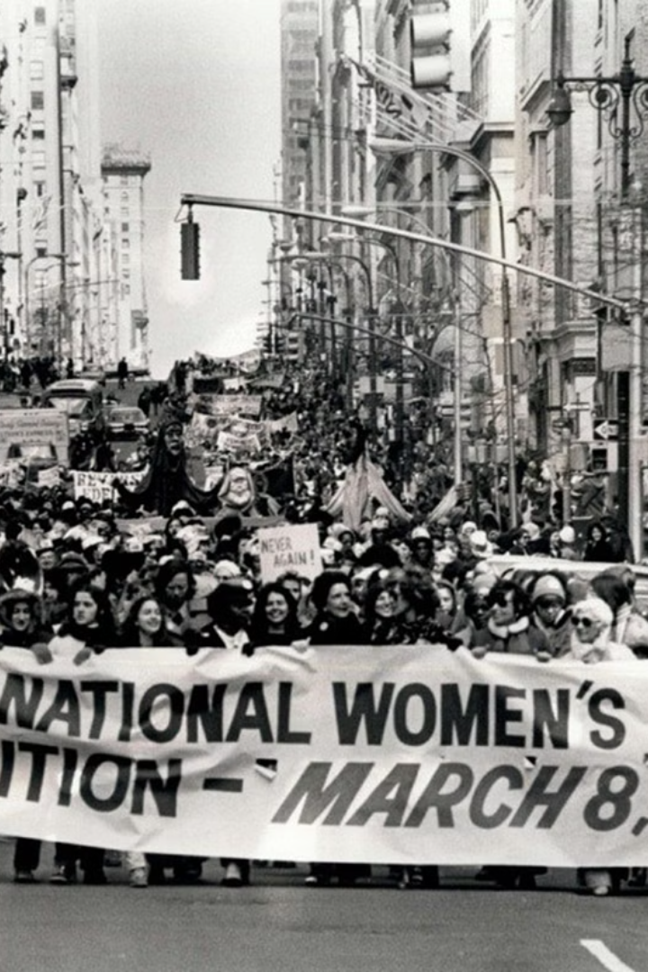

Introduction to International Women's Day
International Women’s Day is a global day celebrating the social, economic, cultural, and political achievements of women. It is a day to acknowledge and honor the contributions of women to society.
Ta
by Tarannum khatun

Slide 2

History and Significance of International Women's Day
1
Origin
The first International Women's Day was celebrated on March 19, 1911, and in 1913 it was decided to adopt March 8 as the International Women's Day.
2
UN Recognition
The United Nations began celebrating International Women's Day in 1977, leading to a global acknowledgment of women’s rights and achievements.
3
Themes
Each year, the day is marked by a specific theme providing an opportunity to reflect on progress made, to call for change, and to celebrate acts of courage and determination by ordinary women.

Slide 3
Achievements and Progress Made by Women Globally
Political Participation
Economic Empowerment
Advancements in Education
Significant increase in the number of women holding political office and leadership roles globally.
Higher participation in the workforce, entrepreneurship, and business leadership roles.
Increase in literacy rates and higher education attainments among women.

Slide 4

Challenges and Obstacles Still Faced by Women
1
Gender Pay Gap
2
Violence Against Women
3
Underrepresentation
Women globally earn significantly less than men for the same work.
Lack of representation in leadership positions and decision-making roles.
Prevalence of domestic violence, sexual assault, and harmful traditional practices.

Slide 5
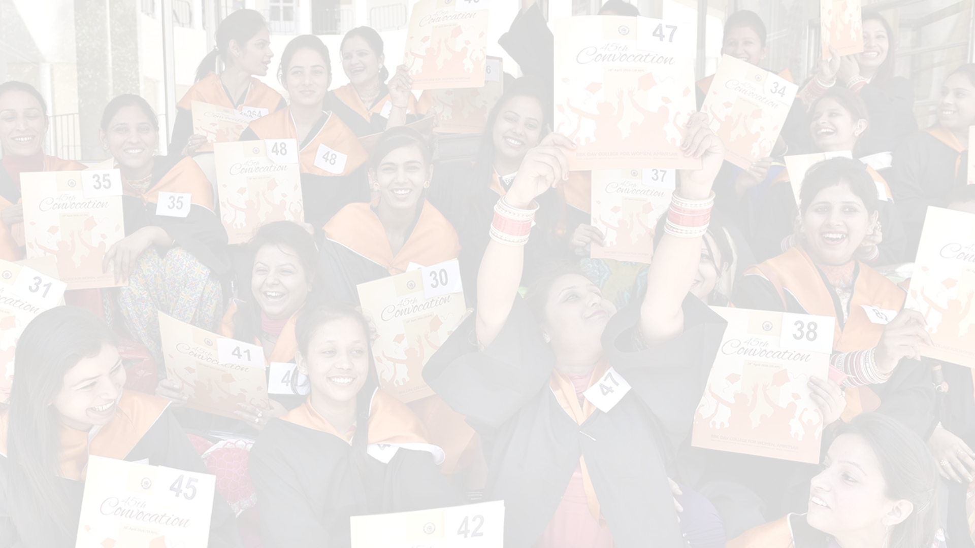



Empowering Women Through Education and Economic Opportunities
Access to Education
Entrepreneurial Support
Equal Pay Advocacy
Ensuring equal access to quality education for girls and women.
Providing resources and training to encourage women's entrepreneurship.
Promoting fair wages and avenues for career advancement for women.

Slide 6

Promoting Gender Equality and Women's Rights
Fighting Discrimination
Legal Reforms
Supporting policies and initiatives that address gender-based discrimination.
Advocating for changes in laws to support women’s rights and autonomy.
Social Awareness
Raising awareness and challenging societal norms that perpetuate gender inequality.

Slide 7
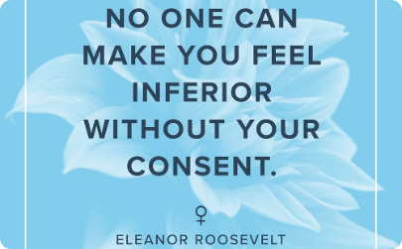


Celebrating Women's Achievements and Contributions
Inspiring Leaders
Artistic Expressions
Community Contributions
Recognizing women leaders making a significant impact in various fields.
Celebrating the creative achievements of women artists and performers.
Honoring women's vital role in community development and social change.

Slide 8
Call to Action: How You Can Support and Advocate for Women's Rights
1
2
3
Education
Workplace Equality
Community Involvement
Support girls' education and access to skill-building opportunities.
Advocate for fair pay, non-discriminatory hiring, and promotion practices.
Engage in community efforts to raise awareness and promote gender equality.

